Slide 1
RUNGTA COLLEGE OF DENTAL SCIENCES & RESEARCH
TITLE OF THE TOPIC – DIAGNOSIS OF DENTAL CARIES
DEPARTMENT OF CONSERVATIVE DENTISTRY AND ENDODONTICS

Slide 2
Specific learning Objectives
At the end of this presentation the learner is expected to know ;
Core areas* | Domain ** | Category #
Zones of dental caries | Cognitive | Must know
Caries activity test | Cognitive | Must know
Caries diagnosis | Psychomotor | Must know
*Subtopic of importance
** Cognitive, Psychomotor or Affective
# Must know , Nice to know & Desire to know
( Table to be prepared as per the above format )

Slide 3
CONTENT
ZONES OF DENTAL CARIES
CARIES ACTIVITY TEST
CARIES DETECTION METHOD
QUESTIONS
REFERENCES

Slide 4
2. DARK ZONE: -
Lies superficial to translucent zone.
Called positive zone as it is always present.
Pore volume is 2 – 4%.
Increased porosity in this zone is due to greater degree of demineralization in this zone.

Slide 5
3. BODY OF LESION: -
Forms bulk of the lesion and lies between relatively unaffected surface zone and dark zone.
Area of greatest demineralization, having a pore volume of 5% near the periphery to about 25% in the center of body of lesion.

Slide 6
4. SURFACE ZONE: -
ν
Interestingly, this zone not only remains intact during the early stages of attack by caries, but also REMAINS MORE HEAVILY MINERALIZED.
Pore volume of only 1%.
Ions for remineralization come either from those within plaque or from reprecipitation of calcium and phosphate ions diffusing outwards as deeper layers are demineralized.
Eventually, this zone is demineralized by the time caries penetrates dentin.
ν
ν
ν

Slide 7
HISTOPATHOLOGY OF CARIES – DENTIN (EARLY CHANGES)
ν
The initial (non infected) lesion in dentin forms beneath enamel before any cavity has formed.
Even though acids formed from fermentation of carbohydrate substrate diffuse into dentin, they leave the organic matrix intact.
Once bacteria penetrate enamel, they spread laterally along DEJ and attack dentin over a wide area.
ν
ν

Slide 8
The infected lesion of dentin is helped in its course by the presence of tubules within dentin which provide an easy pathway to the bacteria.
Bacteria now liberate proteolytic enzymes and bring about destruction of organic matrix of dentin which is already softened by demineralization.

Slide 9
The first change to occur in the caries process within dentin is fatty degeneration of the tome’s fibers, with deposition of lipid globules within these fibers.
This is then followed by dentinal sclerosis, which is minimal in rapidly advancing acute caries and maximum in slow, chronic caries.
This is considered as a protective measure by dentinal tubules to seal off the invading bacteria.

Slide 10
In spite of all these attempts to prevent spread of caries process, dentin is continually destroyed.
Thus behind the zone of dentinal sclerosis a narrow zone of decalcification is seen, just ahead of bacterial invasion of dentinal tubules.
At this stage, only a few tubules are invaded even before clinical evidence of caries.
These bacteria are called “Pioneer bacteria”.

Slide 11
HISTOPATHOLOGY OF CARIES – DENTIN (ADVANCED CHANGES)
Continued decalcification of dentinal tubules leads to their confluence, although the structure of organic matrix may still be maintained for some time.
Confluence of tubules occurs due to packing of the tubules with the invading bacteria.

Slide 12
The coalescence and breakdown of adjacent dentinal tubules leads to formation of “Miller’s liquefaction foci”.
It is an ovoid area of destruction of tubules parallel to the course of tubules and is packed with necrotic debris derived from destruction of tubules.

Slide 13
Continued dentinal destruction by decalcification followed by proteolysis occurs at many focal areas which ultimately coalesce to form a necrotic leathery mass of dentin.
ν
ν
In this mass, clefts occur at right angles to tubules and parallel to the course of lateral branches of tubules or along the collagen fibers of organic matrix.
Due to these clefts, carious dentin can be peeled away in thin layers by hand instruments.
ν

Slide 14
ZONES OF DENTINAL CARIES
Observing from the pulpal side at the advancing edge of carious lesion following different zones can be seen
ZONE 1 – Zone of fatty degeneration of Tomes’ fibers
ZONE 2 – Zone of dentinal sclerosis
ZONE 3 – Zone of decalcification ZONE 4 – Zone of bacterial invasion ZONE 5 – Zone of decomposed dentin
ν
5
4
3
2
1

Slide 15
CARIES DIAGNOSIS
Caries diagnosis is a compound diagnosis that initiates with the detection of a lesion, and also comprises the immediate past caries experience, lesion progression, and the clinical appearance of the lesions.
The diagnosis forms the basis for making informed treatment decisions.
Nyvad et al, CARIES RESEARCH ,2004
Using the metaphor of an iceberg, it can be seen that traditional methods of caries detection result in a vast quantity of undetected lesions.
There is a clinical argument about the signiﬁcance of these lesions, with some authors believing that only a small percentage will progress to more severe disease, however, it is a undisputed fact that all cavitated lesions with extension in pulp began their natural history as an early lesion.

Slide 16
Old diagnostic tools:
Visual method
With temporary elective tooth separation
With temporary elective tooth separation and impression of axio-proximal lesion.
Visual – tactile method with light, mirror and gentle probing
Radiograph method.
Caries acivity tests.
Dyes
Fiber-Optic Transllumination (FOTI)

Slide 17
OLD TRENDS
1. Visual detection
Combination of light and mirror
Most commonly applied method
Sensitivity is low, specificity high
Major shortcoming is that this method is very limited for detecting non-cavitated lesions in dentin on the posterior approximal and occlusal surface.
2. Tactile sensation with explorers
Caries is diagnosed if tooth meets the ADA criteria of softened enamel that catches an explorer and resists its removal or allows the explorer to penetrate proximal surface under moderate to firm probing pressure.
In recent years, it has been shown that a sharp explorer may cause cavitations of intact surface enamel with sub surface demineralization and could force cariogenic bacteria into depth of lesion.

Slide 18
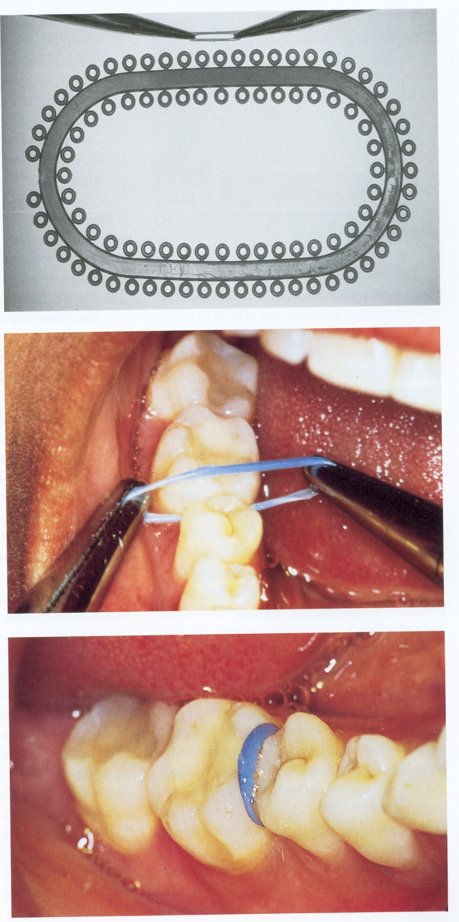
3. Temporary elective tooth separation and impression
Using wedges and elastics
Helps in assessing whether radiographically detectable approximal enamel and dentin lesions are cavitated.
Combined with localized impression allows a more sensitive diagnosis of cavitation.

Slide 19
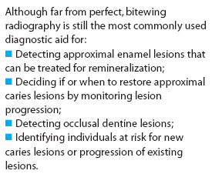
4. RADIOGRAPHS
Bitewing and Intra oral periapical radiographs commonly used.
Also occlusal radiographs, panoramic radiographs are sometimes indicated.
The diagnostic yield that could be gained from a radiograph outweighs the potential adverse effects of exposure to radiation.
The most useful intraoral radiographic tech for caries detection is the bitewing projection
Periapical radiographs may be equally useful,however they are, primarily prescribed for detecting changes in periapical region.

Slide 20
DIGITAL RADIOGRAPHY
Introduced by Dr. Francos in 1989.
A digital image is an image that is recorded with a non-film receptor. Digital imaging is the result of X-ray interaction with electrons in electronic sensor pixels, conversion of analog data to digital data, computer processing, & displays of the visible image on a computer screen.
Components include X-ray source, electronic sensor, a digital interface card, a computer with an analog- to- digital converter (ADC), a screen Monitor, software, & a printer.
Two of well established receptor systems available are
The charge coupled device (CCD)
The storage phosphor image plate (PSP)
In CCD systems , a wire connects the sensor and the computer , and the image is displayed almost immediately on computer monitor after exposure of the sensor.

Slide 21
4. XERORADIOGRAPHY
It is similar to photocopy machine
picture of the body is recorded on paper rather than on film.
Consists of Aluminum plate coated with selenium which provides a uniform electrostatic charge
X- rays → selective discharge of particles → Latent image
Processing unit: Latent image → positive image
Very good Edge enhancement i.e., differentiating areas with different densities
Wide lattitude of exposure

Slide 22
5. CARIES DETECTOR DYES. Van de Rijke (1991) reviewed the use of dyes in cariology Used clinically to differentiate between outer carious dentin and inner affected dentin Outer carious dentin is distinctly stained.
Fluorescent
Fluorol 7 GA - sodium fluorescein
Zyglo ZL -22, pyrromethene 556.
Non fluorescent
1% acid red in propylene glycol
Carsolen green
Lissamine blue

Slide 23
6. ENHANCED VISUAL TECHNIQUES: FIBEROPTIC TRANSILLUMINATION (FOTI)
The basis of visual inspection of caries is based upon the phenomenon of light scattering.
When enamel is disrupted, for example in the presence of demineralisation, the penetrating photons of light are scattered which results in an optical disruption. In normal, visible light, this appears as a ‘whiter’ area—the so called white spot
Fibre optic transillumination takes advantage of these optical properties of enamel and enhances them by using a high intensity white light. The scattering effect can be seen as shadows in enamel and dentine
Principle
A caries lesion has a lowered index of light transmission; and area of caries appears as a darkened shadow that follows the spread of decay through the dentin.

Slide 24
Advantages
simple examination technique.
non invasive
comfortable to patient
does not require any special training for operator
overcomes the problem of unreadable surfaces on radiographs
no radiation hazards
Disadvantages
considerable intra and inter observer variation
not possible to use it at all anatomic locations
no permanent records
less sensitivity and less effective than radiograph

Slide 25
7. FLUORESCENT TECHNIQUES
Visible light fluorescence- QLF
Laser fluorescence- Diagnodent
ORIGIN OF FLUORESCENCE—
Fluorescence is a phenomenon by which an object is excited by a particular wavelength of light. The electrons move to higher states following absorption & fall back to their original states , emitting energy in form of light.
The fluorescent (reflected) light is of a larger wavelength.
When the excitation light is in the visible spectrum, the fluorescence will be of a different colour.
The first to use the fluorescence images for detection of incipient carious lesions in man were Bjelkhren et al.
These authors used blue 488 nm light from an Argon ion Laser to excite the yellow orange fluorescence which was observed at wavelengths above 520 nm.

Slide 26
Quantitative Light-induced Fluorescence
Principle
The loss of mineral from an area of enamel results in a change in its optical properties, with an increase in the scattering of incident light and a decrease in the amount of fluorescence.
There’s a direct correlation between the amount of mineral loss and decrease in fluorescence allowing for quantification of mineral loss.
In the case of the QLF the visible light has a wavelength (w) of 370 nm, which is in the blue region of the spectrum.
The resultant auto-fluorescence of human enamel is then detected by filtering out the excitation light using a bandpass filter at w> 540 nm by a small intra-oral camera.
This produces an image that is comprised of only green and red channels (the blue having been filtered out) and the predominate colour of the enamel is green.
Demineralisation of enamel results in a reduction of this auto-fluorescence. This loss can be quantified using proprietary software and has been shown to correlate well with actual mineral loss
Review Caries detection and diagnosis: Novel technologies j o u r n a l of de n t i s t ry 3 4 ( 2 0 0 6 ) 72 7 – 73 9

Slide 27
Technique
The QLF device consists of the light source and the intraoral camera
The QLF technique is a 2-stage process.
First, an image of the tooth must be acquired with the intraoral camera held in the hand. Live images are displayed via a computer and accompanying software enables patient’s details to be entered and individual images of the teeth of interest to be captured and stored.
Then, both qualitative and quantitative assessments of mineral loss are obtained.
The enhanced contrast (more than 20 times that which can be detected clinically) between sound and demineralized enamel enables the clinician to identify areas of concern.
QLF is a more versatile system than either DIAGNODent or DIFOTI and can measure absolute mineral loss .
It has a number of other applications-
Detecting incipient caries in permanent teeth, adjacent to restorations and orthodontic brackets, in primary teeth
in clinical trials of dentifrice products
to detect failing fissure sealants,
to detect root caries.
to monitor enamel erosion in vitro.

Slide 28
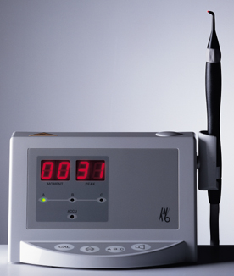
DIAGNODent Laser Device
A chairside, battery-powered quantitative diode laser fluorescence device by KaVo, Lake Zurich, Ill which uses laser fluorescence to detect incipient caries.
It measures the fluorescence of bacterial products within carious lesions — namely, porphyrins— rather than crystalline disintegration. (JDR 83,2004)
This theory is supported by the fact that the DIAGNODent device does not detect lesions produced in the laboratory by means of acidic buffers, which produce no microbiological activity. ( JCDA,VOL 70, SEP 2004)
The device generates a laser beam that is absorbed by materials within the tooth and is subsequently re-emitted as infrared fluorescence.
The DIAGNODent device is compact, portable and fully compliant with cross-infection control directives. It consists of a control unit and a hand-held probe.
The probe comes with 2 attachments, one with a small tip, for examining fissure caries, and the other with a larger, broader tip, for examining smooth surfaces.

Slide 29
Improved Technique for early diagnosis of noncavitated occlusal lesions.
The only FDA-approved and over-90%-accurate device, the DIAGNOdent (KaVo) allows this detection. It shines a red laser into the occlusal subsurface via a specially designed hand piece and tip. As the laser detects demineralized tooth substances and bacteria products, it produces fluorescence. The fluorescent light comes back, interacts with the detector, and is read out as a number and an audible signal if there is a lesion.
Numbers 15-30 -need preventive remineralization or operative care depending on the caries risk assessment.
Numbers over 30 -indicate the probability of a subsurface lesion and need for operative care.

Slide 30
Interpretation of values
Display value:
Therapy:
0 - 14
No special measures.
15 - 20
Usual prophylactic measures.
21 - 30
More intensive prophylaxis or restoration: indication is dependent on
caries activity.
caries risk.
recall interval, etc.
from 30
Restoration and more intensive prophylaxis.

Slide 31
Potential New Diagnostic Modalities for Caries Lesions
1.Multi-photon imaging
2. Infrared thermography
3.Optical coherence tomography
4.Ultrasound
5.Terahertz imaging
6. Infrared fluorescence
7.Magnetic resonance microimaging
8.Tuned aperture computed tomography
9.Microradiography

Slide 32
CARIES ACTIVITY TESTS
DENTAL CARIES
It is an irreversible progressive disease of multifactorial in nature affecting the calcified tissues of the teeth characterized by demineralization of inorganic portion & destruction of organic portion of the tooth.

Slide 33
CARIES ACTIVITY
Refers to the increment of active lesion (new and recurrent lesions) over a stated period of time
Caries activity is a measure of speed of progression of a carious lesion.
CARIES SUSCEPTIBILITY
Refers to the inherent tendency of the host & target tissue, the tooth to be affected by the carious process

Slide 34
REQUIREMENTS OF CARIES ACTIVITY TESTS
Test should be reproducible & valid
There should be good correlation between the caries activity scores & actual caries development
Should be simple
Results should be obtained rapidly, within hours or few days
Should have measurement of mechanisms involved in caries process
Should be inexpensive, non-invasive & applicable to any clinical setting

Slide 35
CARIES ACTIVITY TESTS:
Lactobacillus colony count test
Saliva is collected by chewing paraffin before breakfast
The specimen is vigorously shaken and after that 0.1 cc of sample is withdrawn
Dilute and undiluted samples are then spread evenly over a rogosa’s SL agar plate
The plate is incubated for 4 days & no. of lactobacillus colonies that developed are counted.

Slide 36
No of organisms 1-1000 1000-5000 5000-10,000 More than 10,000 | Symbolic designation + + ++ +++/++++ | Degree of caries activity suggested Little or none Slight Moderate Marked

Slide 37
SNYDER TEST
This test measures the ability of salivary microorganisms to form organic acid from a carbohydrate medium.
The classical formula of Snyder’s agar per litre of purified water is
pancreatic digest/ casein -13.5 gm
yeast extract -6.5 gm
dextrose -20 gm
sodium chloride -5 gm
agar -16 gm
Bromocresol green -0.029 gm

Slide 38
24 hrs 48 hrs 72hrs Color : yellow yellow yellow Caries activity: marked definite limited
Color : green green green Caries activity: continue test continue test continue test

Slide 39
ALBEN’S TEST
It is a modified Snyder test
At the time of test 5 ml, tube of semisolid agar is removed from refrigerator but is not heated
The patient is asked to spit unstimulated saliva directly in to the tube. Tube is incubated for 4 days.
SWAB TEST
Advantage is no collection of saliva is necessary
Valuable in evaluating caries activity in very young children
Principle is same as Snyder test
The oral flora is sampled by swabbing the buccal surface of tooth with cotton.

Slide 40
REDUCTASE TEST
This test measures the activity of reductase enzyme present in salivary bacteria
The sample is mixed with fixed amount of diazo-resorcinol
The change in color after 15 min is taken as a measure of caries activity

Slide 41
color | Time score | Caries activity
Blue Orchid Red Red pink | 15min 1 15 min 2 15 min 3 Immediately 4 Immediately 5 | Non conductive Slightly conductive Moderately conductive Highly conductive Extremely conductive

Slide 42
ENAMEL SOLUBILITY TEST
It is based on the fact that when glucose is added to saliva containing powdered enamel, organic acids are formed
Organic acid decalcifies the enamel, resulting in an increase in the amount of soluble calcium
The extend of increase of calcium is a direct measure of caries activity

Slide 43
SALIVA FLOW TEST
Flow rate is determined by collecting paraffin stimulated saliva in a test tube over 5 min
Severely decreased flow is related to caries susceptibility
As salivary flow rate decreases viscosity increases

Slide 44
PATIENT EDUCATION WITH METHYL RED
A simple and effective technique that may be of assistance in educating child patient to the problem of dental caries control involves the use of aqueous solution of methyl red
Indicator dye changes colour in the pH range from 6.3(distinct yellow) – 4.2(red)
Aqueous methyl red is then applied to the surface of the tooth with dropper
Red colour is developed in the area of plaque accumulation
This is interpreted to patient as evidence of continuous acid formation

Slide 45
TAKE HOME MESSEGE/ FOR THE TOPIC COVERED (SUMMARY)
“Prevention is Better than cure”,so it is imperative that we,as a Dentist should focus on Treating not only those who are ill,but also treat those who are more likely to get ill….
We have variety of new agents which can be used to prevent dental caries but application of these agents in clinical trail is still limited in developing countries.
Moreover dental caries is a multifactorial & prevention measures
Should be evaluated properly in human trials so they can be introduced at community level for prevention of dental caries

Slide 46
Question & Answer Session
Write in short about caries activity test.
Write in short about histopathology of dental caries.
Write in short about zones of dental caries.
Classification of dental caries.
Short note on etiology of dental caries.

Slide 47
REFRENCES
John I. ingle,DDS,MSD Endodontics Fifth edition
M.A.Marzouk,A.L.Simonton,R.D.Gross Modern Theory and Practice Operative Dentistry.
Shaffers Textbook Of Oral Pathology and Medicine

Slide 48
THANK YOU

